Slide 1

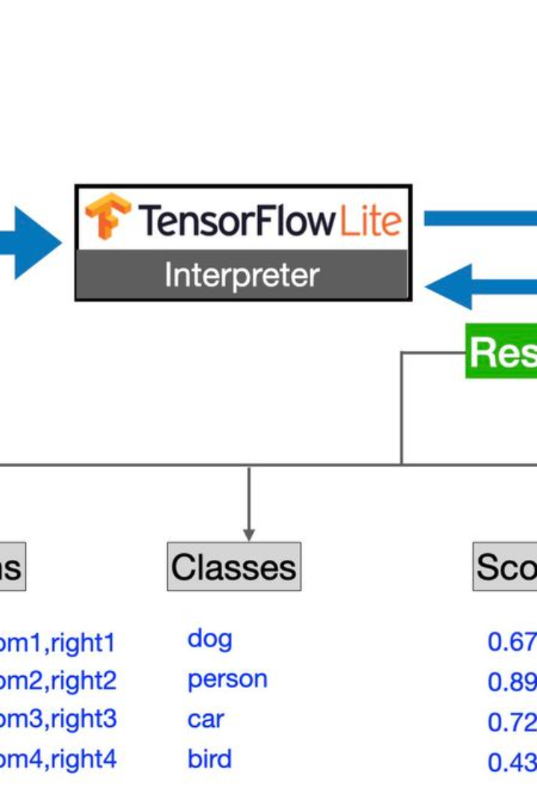
Introduction to TensorFlow Object Detection
TensorFlow Object Detection is a powerful tool for identifying and locating objects within an image or video. It's widely used in fields like autonomous vehicles, retail, and healthcare for tasks such as object tracking, facial recognition, and more.
by laya etesam

Slide 2
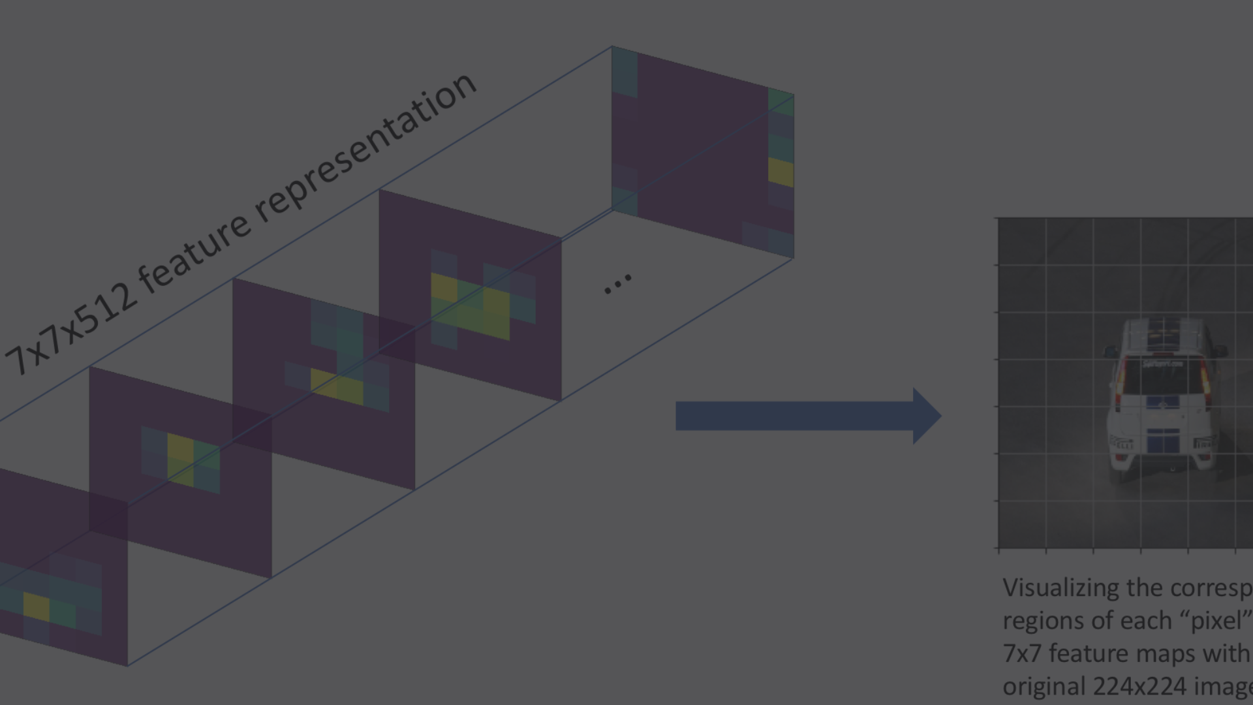
What is Object Detection?
1
Detection of Multiple Objects
2
Contextual Understanding
3
Applications in Various Industries
Object detection involves identifying and locating multiple objects within an image or video, often in real-time.
It goes beyond image classification and provides context by outlining the exact location of each object.
From security and surveillance to retail analytics, object detection has a wide range of applications across different fields.

Slide 3
Overview of TensorFlow
3.3K
5
GitHub Stars
Dimensions
TensorFlow has garnered a massive community with 3.3K stars on GitHub, indicating its popularity and strong support.
TensorFlow offers flexibility with support for both static and dynamic graphs, making it suitable for various applications.

Slide 4
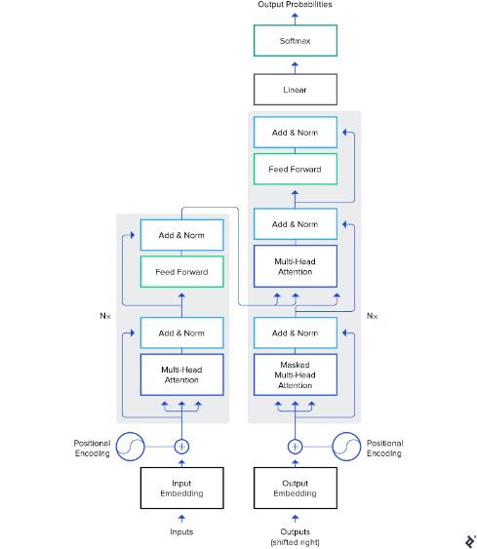
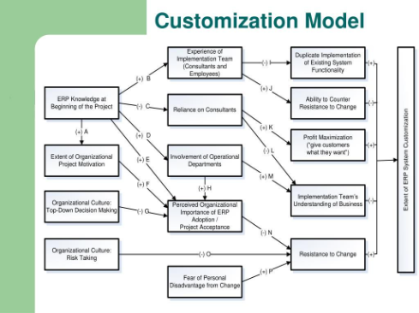
Key Features of TensorFlow Object Detection API
Efficient Pre-Trained Models
Easy Model Customization
The API comes with pre-trained models, allowing for quick implementation and efficient use for various tasks.
It provides tools to train and fine-tune models for specific use cases, ensuring flexibility and tailored performance.

Slide 5
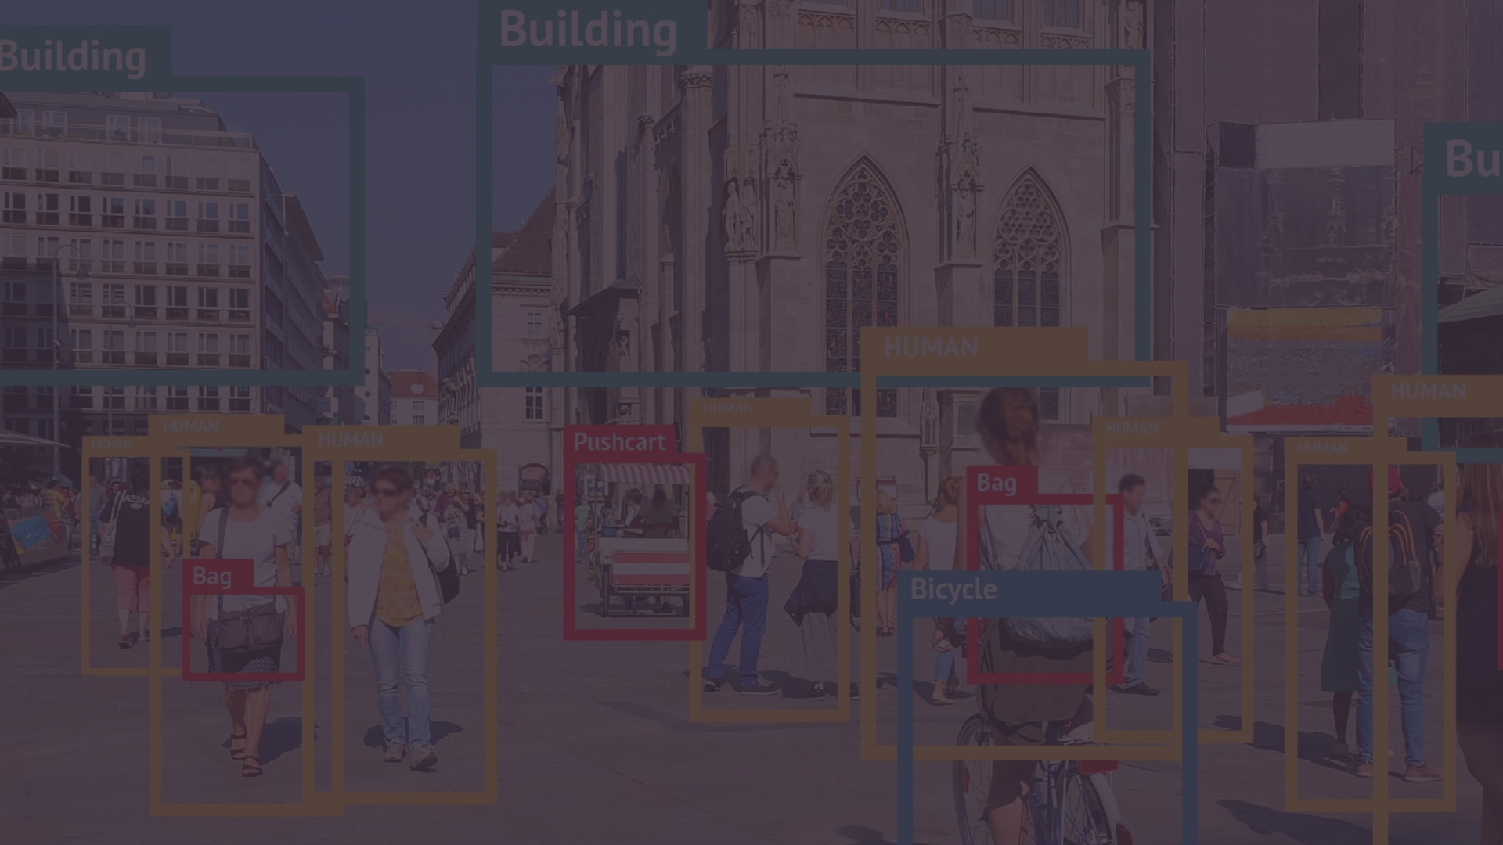
Training a Custom Object Detection Model
Data Collection
Annotation
Model Training
Effective data collection ensures a diverse and representative dataset, crucial for robust model training.
Accurate annotation of training images is essential for teaching the model to recognize objects.
Training involves the process of optimizing model parameters to accurately identify objects within an image.

Slide 6
Evaluating and Fine-Tuning the Model
Evaluation Metrics
Quantitatively assesses the performance of the model using metrics like precision, recall, and F1 score.
Fine-Tuning Techniques
Techniques such as transfer learning and hyperparameter tuning help optimize and refine the model's performance.

Slide 7
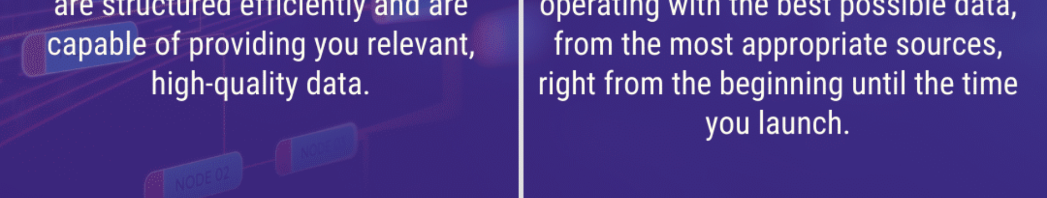


Deploying the Model for Inference
Model Integration
Inference Process
Integrate the model into the desired application or system, ensuring seamless communication and functionality.
Execute the trained model to make predictions and detect objects within new data instances.

Slide 8
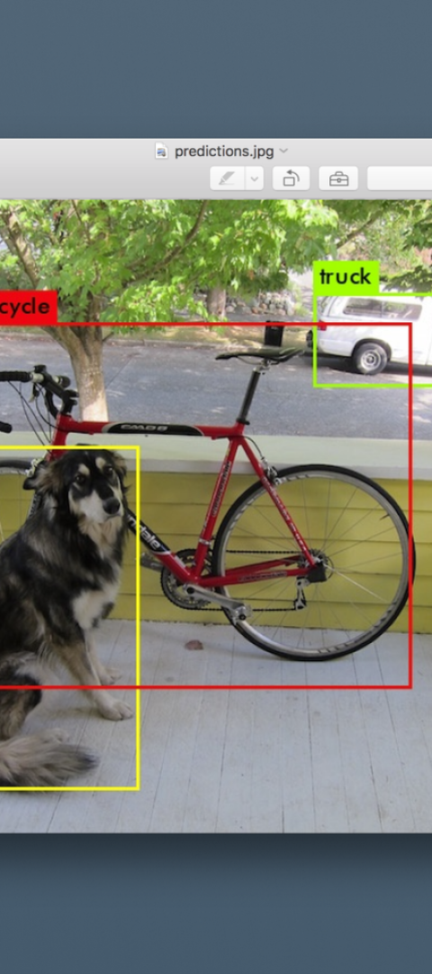
Case Studies and Applications
1
Autonomous Vehicles
Object detection plays a crucial role in enabling autonomous vehicles to recognize and respond to their environment.
2
Retail Analytics
It enhances retail operations by providing insights into shopper behavior and inventory management.
3
Healthcare
Used for tasks such as medical image analysis and detecting anomalies in medical scans, improving diagnosis and treatment.

